Slide 1
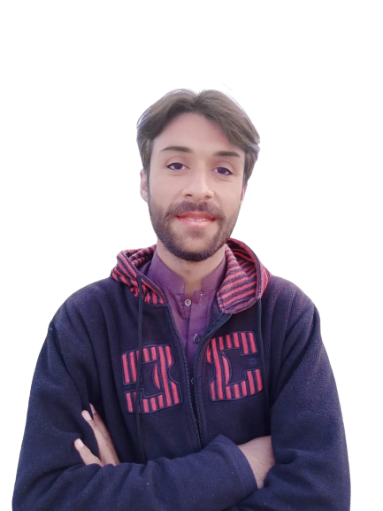
Complex Task Series
Problem Number 6

Slide 2
Problem Statement
Create a web application in python to make a hello world program

Slide 3
Algorithm
Step1: Install Python Django Library
Step2: Create Project
Step3: Create application and include in settings.py file in Django project
Step4: Create template in application and create html file in application template
Step5: Write URL and View for web page that need to be render
Step6: Write hello world in HTML document to display result to browser
End

Slide 4
Assignment
Create a web application in python to make percentage calculator and design with CSS coding

